Slide 1
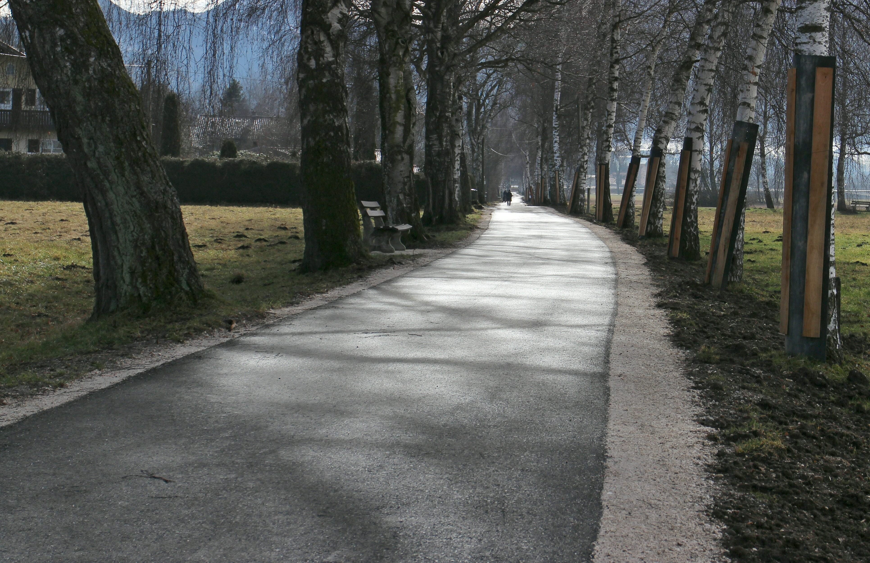
Adopt & Adapt:
Fill gaps and drive momentum

Slide 2
About
About Louise
Experience Architect for the City of San Antonio, Web Design Manger for 10 years.
CXA & CUA (also Adobe, HyCurve, Microsoft, and others)
BFA Theatre (Costume Design)
USCG Reserve
Experience with
Costume, Film, and 16th C. reproduction ship
Fortune 500 enterprises
Government
Education
Involved with UX for 20 years
Fusing Art Glass
Notes:
Read our straight bios on LinkedIn

Slide 3
A STORY in three acts

Slide 4
Act One: The Lone Ux Resource
Developer culture, complex bureaucracy, deep-rooted legacy culture
Managed complex network of websites and team of web designers
Lots of demand, many constraints — design “make it pretty”, no interest in research/validation with end-users
Started with UCD web redesign process for the team (Discovery, Definition, Design, Development, Deploy)
Notes:
Focused teams on a few key deliverables
Site diagrams, wireframes, mockups, click-throughs for testing

Slide 5
Act Two: Getting Traction
Leadership gets it and supports (to an extent – still working on budget!)
CUA seats – strategically selecting, Big challenges of “on top of their existing job”, not a dedicated UX role.
Build a Program quickly (limited resources) - Started amassing examples of all the UX info I could find — resource list.
CxG (Customer Experience Governance) – big opportunity with executive leadership participation
Raising awareness… No Design is still Design No UX work = UX DEBT and poor customer experience

Slide 6
Act Three: Culture Change & Scaling
Work on every project with user impact? Not scalable
Stop and create a whole program?
No time
Mentor people on projects?
Need basic UX competence
Notes:
Chicken or the Egg

Slide 7
CHOOSE TO FOCUS ON
TRAINING
Scale Lone UX Resource (Louise)
Train on 5 levels (Awareness, Content Contributors, Creators, Facilitators, Practitioners
Engage vendors
PRIORITIZING
Reduce overwhelm
Major CX facing products – like the web platform
ADOPT & ADAPT
Stay sane

Slide 8
ADOPT & ADAPT Resources

Slide 9
PROGRAM resources
Challenges
Governance
Strategy

Slide 10
HCD CULTURAL resources
ROI
EcoSystem
Content
Inclusion
Notes:
No Design is still Design
No UX = UX DEBT

Slide 11
PROJECT resources
Evangelizing
Awareness, Training, Community
Guidance
Tools
Notes:
No Design is still Design
No UX = UX DEBT

Slide 12
ACTIVITY resources
Getting Started
Methods
Analysis, Documentation, Deliverables
Metrics, Testing
Notes:
No Design is still Design
No UX = UX DEBT

Slide 13
Adopt & Adapt Resource List
Http://bit.ly/ADOPTADAPTUX
Notes:
https://firecatstudio.com/wp-content/uploads/2021/09/BigDesign-UX-Adopt-Adapt-Resources.pdf

Slide 14
Moving Forward

Slide 15
Next Steps, Scaling
Allies
Awareness for Leadership and General Employee
InfoGraphics, Short Talks & Presentations
Facilitators, Developers, Content Creators
UX Crash Course (HFI) 1 day
Online Self-paced training “Playlist” (LinkedIn Learning)
In-depth training with certification: CUA, CXA
Community
Encourage community participation with Firecat and UXSA
Weekly Community of Practice
Writing for Trust, Quality, and Inclusion
UX Practitioners
Leaders & Sponsors
Facilitators
Creators
Training

Slide 16
Maintaining Traction
Empathy (Allies)
Find and embolden your champion
Start where you are with small, doable next actions: eat the elephant one bite at a time​
Positive reinforcement: Make UX interactions a help, not a burden​
Packages
Create small, medium, and large UX principles, process, and patterns​
Feedback
Build in feedback loops​
Track simple data and share in regular reports with stakeholders​
Create sharable infographics
Usability test results & video highlights
Community
Develop a community of practice
Make it FUN, welcoming, generous, and helpful

Slide 17
Thank You
Louise Craig
Email: louise.craig@sanantonio.gov
Linked In: https://www.linkedin.com/in/louisecraig/

