Slide 1
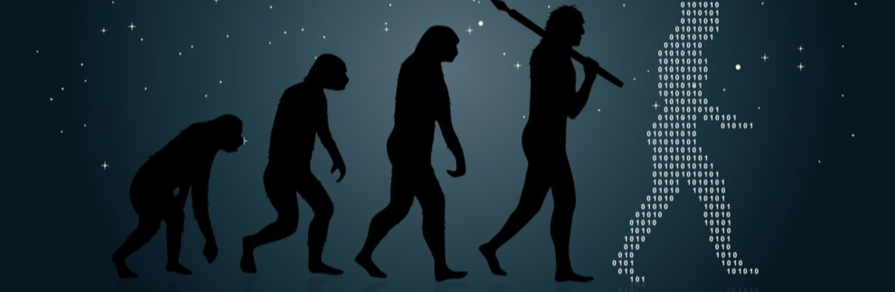
From 1.0 to N.0
Rajesh Nair
Director of Engineering
Dell Technologies

Slide 2
Agenda
About me
What brings us here
Building software that lasts
Things to keep in mind
Navigating tough choices
Q&A

Slide 3
About me..
24 years in the software industry – Developer, QA, Management
Engineering Director at Dell Technologies
Extreme passion for Ux, no associated degrees though. ☺

Slide 4
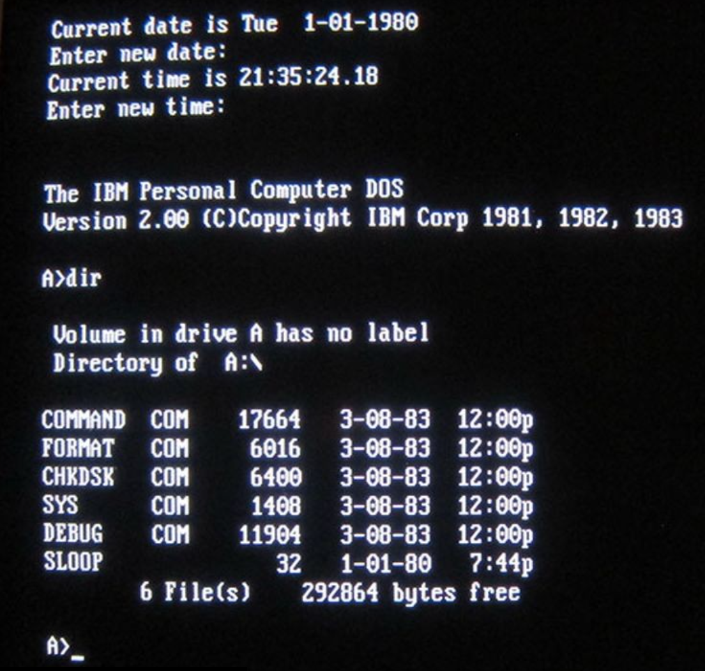
Once upon a time..

Slide 5
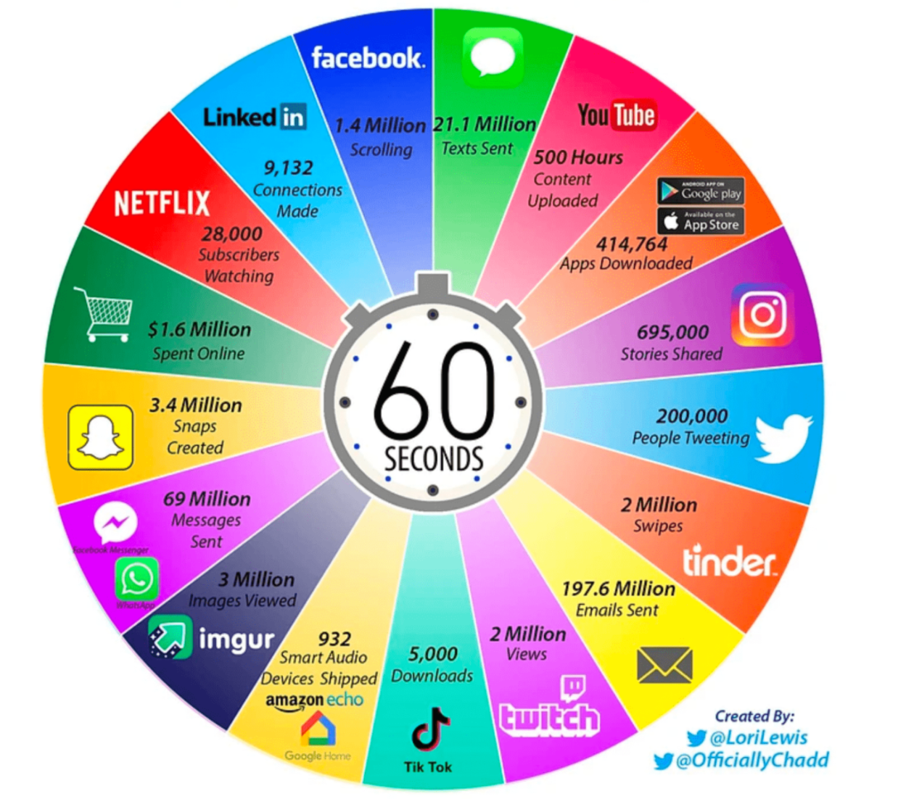
..an Internet minute in 2021

Slide 6
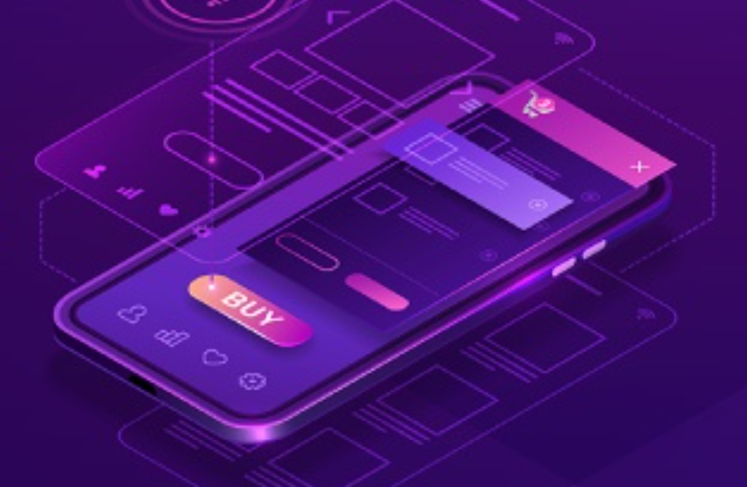
What has changed?

Slide 7
Time = Money
Smarter
Faster
Better
When I give you my time, I am providing you with value.
When I do something I "spend" my time, I can "waste" my time.

Slide 8
Customer profiles
Baby boomers to Millennials to Gen Z
Local vs Global
Hierarchical vs Flat organizations
A more connected world

Slide 9
The many devices..
Desktops
Tablets
Mobile phone

Slide 10
Release cadence
Agile vs Waterfall
From ‘every 3 years’ to ‘every 3 months’ to ‘continuous delivery’

Slide 11
Surfing big waves

Slide 12
Redesigning and refactoring between releases
Focus on the experience, not on the technology
Customer validation
Design ahead of development

Slide 13
Changes in product direction
Be Customer-Centric In Your Communication
Make It Simple And Personal
Be Available
Survey Your Customers First
Let Customers Be Part Of The Journe
Be Transparent
Give As Much Advance Notice As Possible
Be Brutally Honest
Communicate To Build Trust
Let Them Adopt The Change At Their Own Pace
Position The Change As An Improvement
Have A Clear And Consistent Message
Understand Their Concerns About The Change
Offer A Beta Test
Consider What’s Most Important To Your Customers
https://www.forbes.com/sites/forbescommunicationscouncil/2021/03/08/15-reassuring-ways-to-tell-customers-about-service-changes/?sh=785dcd166673

Slide 14
Takeaways..
Stick to the products main purpose
Your product has a purpose and goal. Don’t deviate from it between releases.
Don’t change things upside down
Changes must be gradual and should put customer at ease. A release is a release, not a new product.
Assume the customer knows nothing
Just because he has been using it already, don’t assume he knows it all
Don’t put beauty over function
If what you added is beautiful but doesn’t function, it still doesn’t meet his expectations

Slide 15
Q & A
rajeshkunhiraman@yahoocom
https://www.linkedin.com/in/rajeshkunhiraman/

